Slide 1
School management system
Ashwini.k

Slide 2
Introduction
The school management system is an application developed for schools. It is an application developed in Java which is used to store all the school-related records. It stores information related to students, staff, and teachers. The objective of developing such a system was to reduce the errors that creep in the manual system where it was very difficult to store the records. It also provides the facility to calculate the attendance of the student. There are four types of login for this system the administrator, student, teacher and staff login. The whole system is handled by the administrator who has all the rights to editor modify any school member information.. This system was developed to provide a secure, easy to use a reliable system. This was created to handle all the school-related information and save it in records

Slide 3
Modules
Admissions management
Student management
Learning management
Examination management
Faculty management

Slide 4
Software requirements
Front end : java
Back end : SQL Server 2005

Slide 5
Hardware requirements
Processor : intel core i5
Hard disk : 8GB
Ram:216MB

Slide 6
Existing system
In the earlier system, it was difficult to store all the student, teacher and staff records which required a lot of paperwork and time consumption. It also leads to errors and mistakes. Everything like attendance has to be marked manually. These systems also caused redundancy of data. If any records need to be updated then it has to be changed in every file so making it difficult to manage all the data. There was no security as anyone can view those records. So there was the need for developing an automated system which could handle all these problems making the system easier to use.

Slide 7
Proposed system
Now the proposed system is developed to solve all the problems that occurred in the earlier systems. It provides a user-friendly interface where there is an administrator which only has the privilege to access the data. This makes system secure and reliable. This system allows to keep track of the student’s attendance and maintain all the staff information. So everything becomes easy thus reducing the risks that come with an existing system. We have collection of many java projects with source code which can be used by students for their academic work

Slide 8
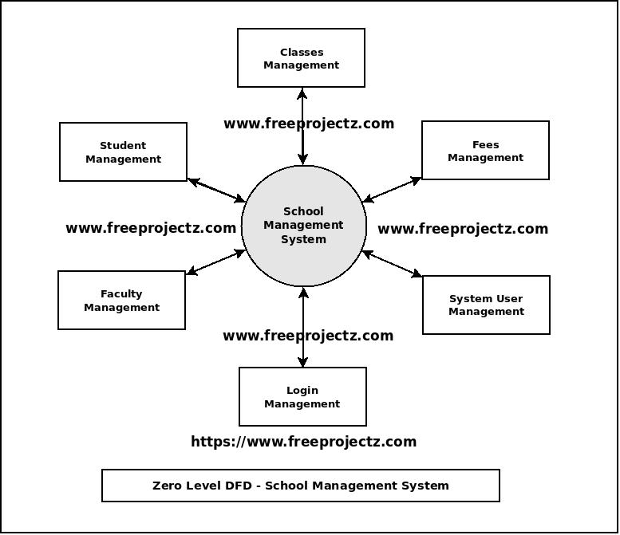
flowchart

Slide 9
Modules of school management system
School attendence
School fee management
Library management
Exam and results
Student information
Bus Transport and GPS
Online Registration

Slide 10
Admission management
Admin login
Student login

Slide 11
Admin login
Enter name
Enter password
admin
…..
login

Slide 12
Student management
Name
Student id
Course
Information
Grade

Slide 13
Learning management
subjects

Slide 14
Examination management
Name
Student id
Course
Exam fees
(feespaid+feestotal)

Slide 15
Faculty management
Faculty member
Personal information
Salaries
feedback

Slide 16
Advantages of SMS
1- Saves time It saves instructors valuable time from administrative tasks. ...
2- Very beneficial in report making The primary advantage of school management software for school managers and directors is the variety of reports generated inside the program, ...
3- It closes the communication gap ...
4- It handles the lifetime data of students ...
5- Timetable management ...
6- It provides safety for students ...

Slide 17
conclusion
Conclusion The project work titled “School Management System” has been designed using PHP Hypertext Pre Processor (PHP) where in many user friendly form controls have been added in order to make it a user interactive application. The system is developed in such a way that the user with common knowledge of computers can handle it easily.

Slide 18
Features of SMS
School management record
Teachers information
Student information
Attendance management
Report card generation
Online assignments and assesments

Slide 19
Thank you

